Slide 1
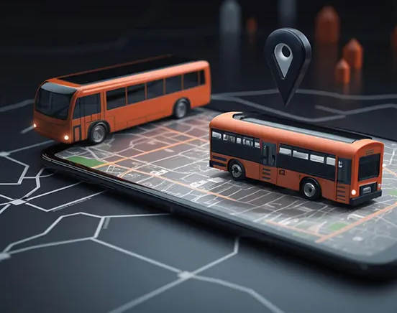
Darwin Public Transport Tracking System
A real-time tracking system to enhance the public transport experience in Darwin.

Slide 2
Problem Statement
Darwin’s public transportation lacks real-time tracking, causing uncertainty and inefficiency.
Commuters face unreliable schedules, missed updates, and ineffective route planning.
Leads to frustration, inefficiency, and dependency on private vehicles.

Slide 3
Solution Overview
Real-time tracking of buses and public transport.
Smart route planning and schedules.
Proactive notifications on delays or route changes.
Integration with Google Maps for ease of use.

Slide 4
Features

Slide 5
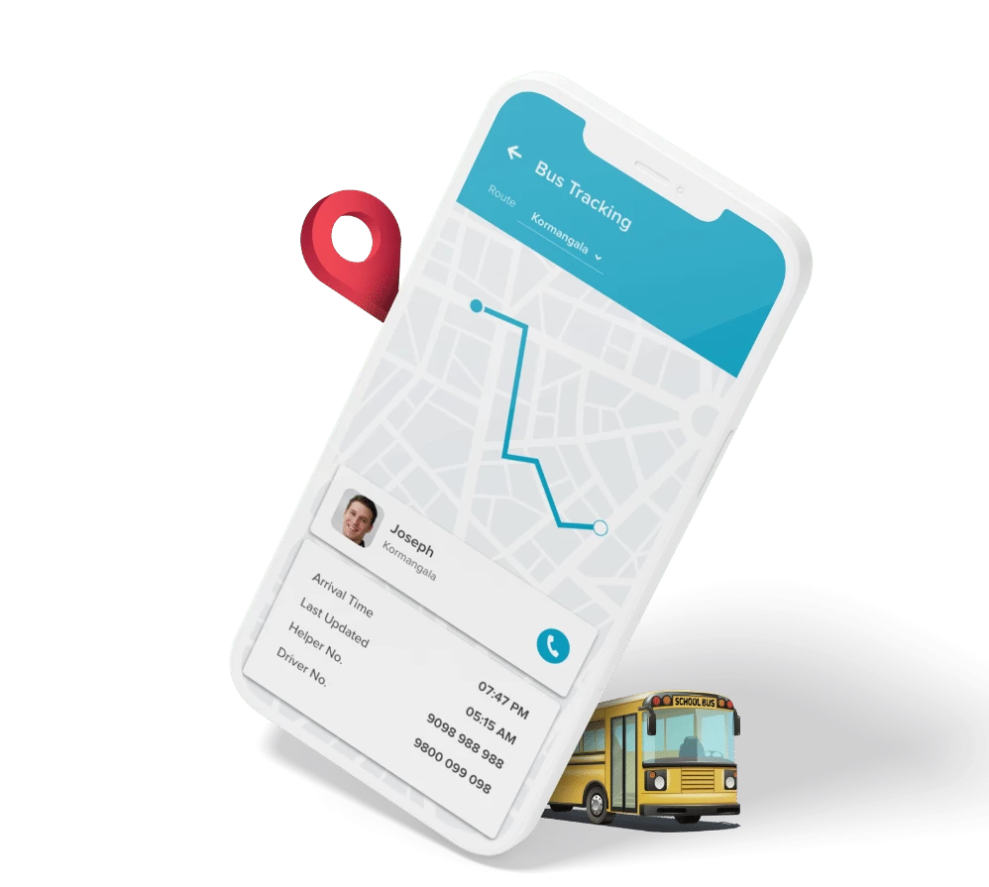
Live Tracking of Public Transport
Real-time location of buses visible to users.
Eliminate uncertainty and enable informed decisions.

Slide 6
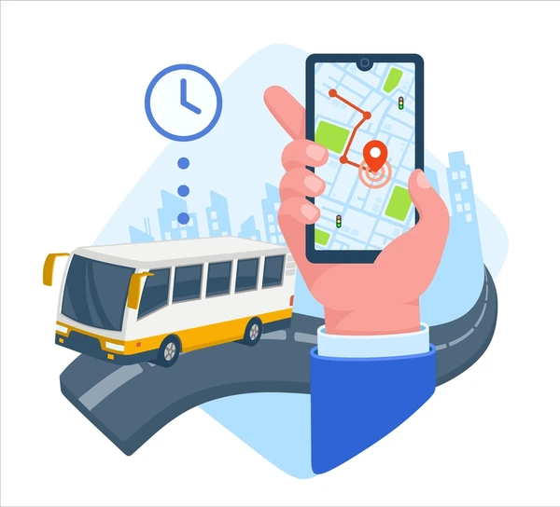
Route Planning & Schedule Information
Access routes, schedules, and estimated travel times.
Helps users select the best possible options.

Slide 7
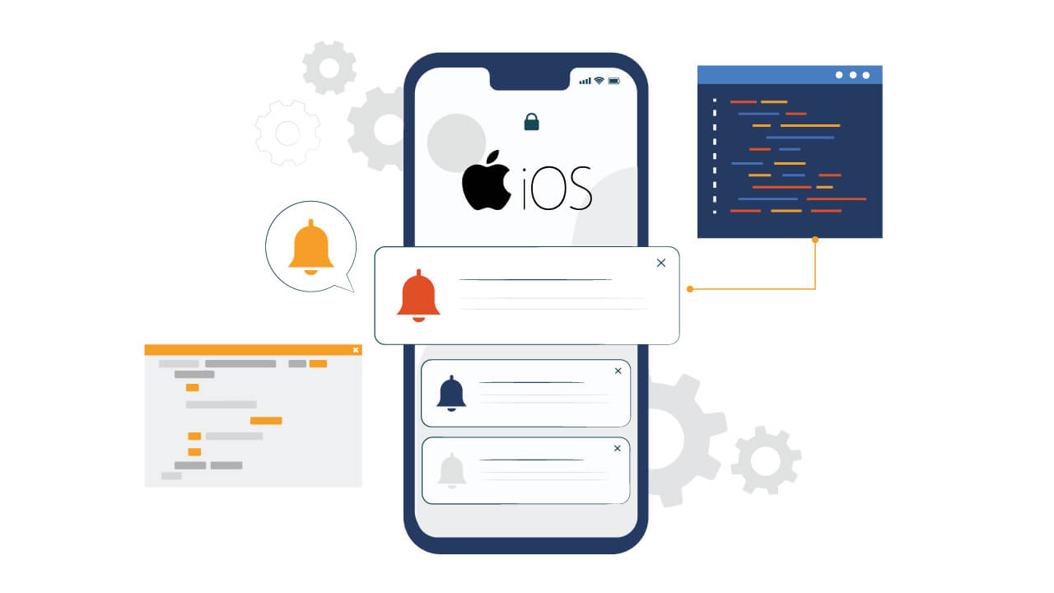
Real-Time Notifications
Alerts for any delays, disruptions, or route changes.
Keeps users informed and prepared.

Slide 8
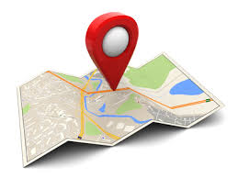
Integration with Google Maps
Familiar interface for route visualization and navigation.
Seamless experience for users already using Google Maps.

Slide 9

Benefits of the System
Empowers commuters with accurate information.
Reduces waiting times, missed connections, and frustration.
Promotes increased use of public transport, reducing traffic congestion.

Slide 10
Conclusion
real-time tracking, dynamic route planning, and proactive notifications
A step forward towards a smarter, more connected city.
Enhances the public transport experience for residents and visitors alike.

Slide 11

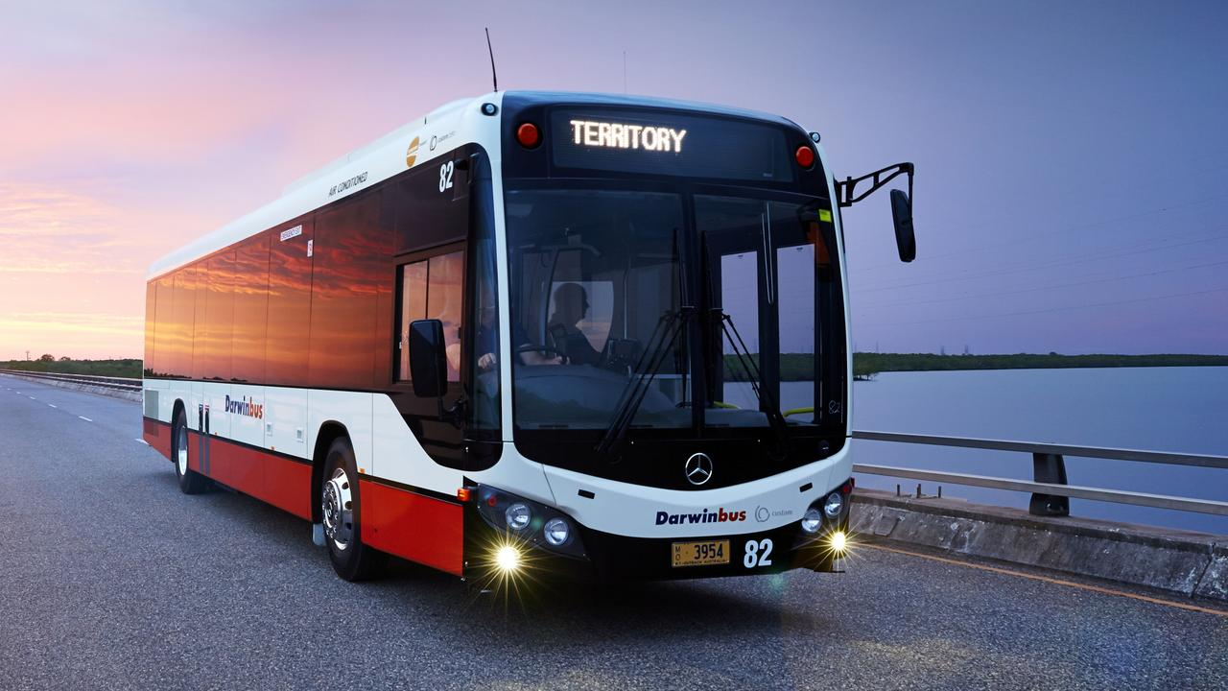
Let’s Make Darwin a Model of Transport Efficiency.

